Slide 1

BLOCKCHAIN & CYBERSECURITY
SOFTWARE PROJECT
Blockchain-Based Academic
Degree Verification &
Credential Authentication
GUIDE
Ms. Chetana Bhagat
PRESENTED BY
Ramsha Siddiqui • Aditya Dhakarge
Tukaram Magar • Priyatam More
B.Tech Computer Science Engineering · ICBT (R)
Academic Year 2025 – 2026
Notes:
1

Slide 2
01 — INTRODUCTION
Why This Project Exists
PROBLEM
NEED
GOALS
APPROACH
Problem Statement
Need of the Project
Objectives
Purpose
Forged degrees and manipulated transcripts undermine trust in academic qualifications.
Manual, document-based verification is slow and error-prone.
No secure, transparent, universally accessible way exists to verify credentials quickly.
Institutions and employers rely on slow registrar communication.
Eliminate fake-degree fraud and build trust between universities and employers.
Create permanent, tamper-proof academic records with instant verification.
Universities issue certificates digitally; proof is stored on blockchain.
Employers verify instantly via QR code or certificate ID.
BEFORE
Traditional Verification
Manual, registrar-dependent, slow
AFTER
Blockchain Verification
Instant, tamper-proof, self-service
INTRODUCTION
2 / 10
Notes:
2

Slide 3
02 — LITERATURE SURVEY
Comparative Study of Existing Systems
Platform | Blockchain Used | Strength | Limitation
Blockcerts | Bitcoin / Ethereum | Open-source; widest institutional adoption worldwide | Public chain — hash-only, limited privacy controls
OpenCerts | Ethereum | Government-mandated; proven at national scale (2M+ certs) | Dependent on Ethereum network fees and congestion
EduCTX | Ark Blockchain | First ECTS-compatible blockchain credit platform | Piloted only; not yet deployed at production scale
Sony Global Ed. | Hyperledger Fabric | GDPR-aligned, privacy-by-design architecture | Permissioned network — limited public verifiability
EBSI | Permissioned (EU nodes) | Cross-border legal framework; W3C VC compliant | Multi-jurisdiction governance remains complex
RESEARCH GAPS IDENTIFIED
No Universal Standard
Privacy vs Immutability
Scalability
Digital Inclusion
LITERATURE SURVEY
3 / 10
Notes:
3

Slide 4
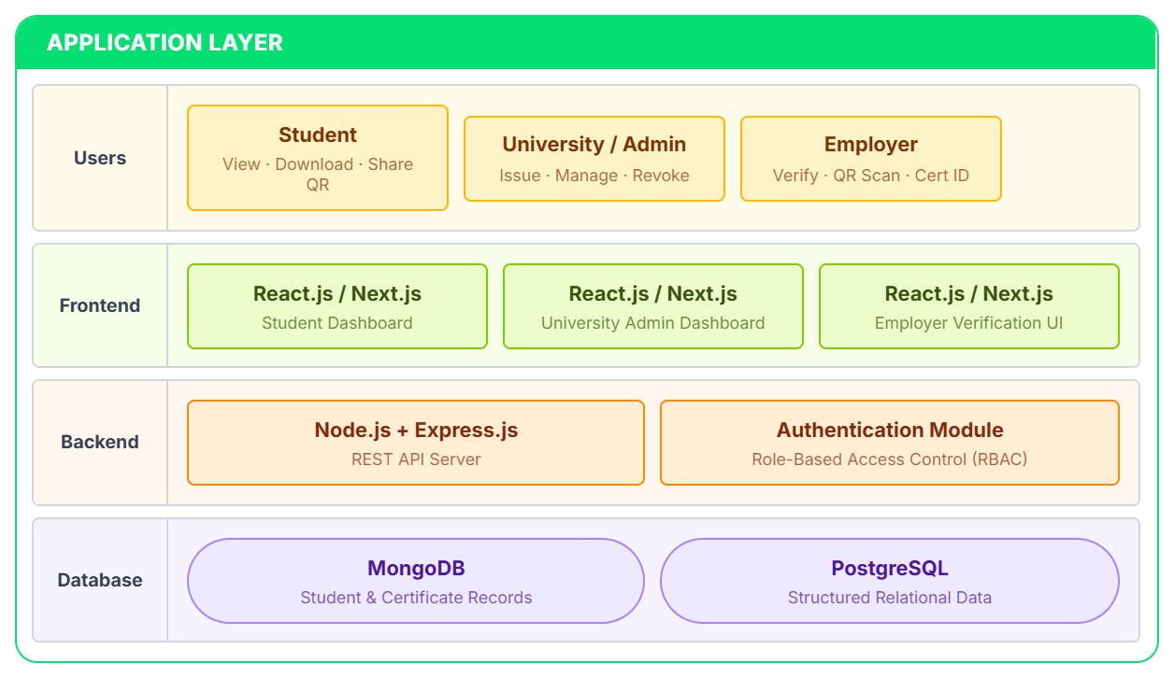
03 — SYSTEM ARCHITECTURE
End-to-End Architecture
Notes:
4

Slide 5
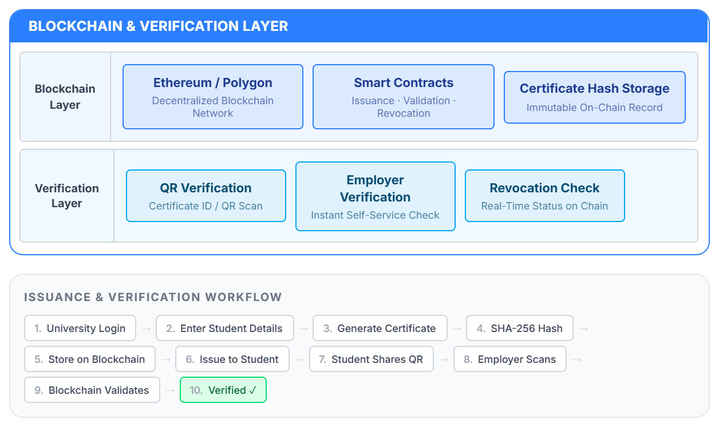
Notes:
4

Slide 6
04 — DATA FLOW DIAGRAMS
DFD — Level 0 & Level 1
LEVEL 0 — CONTEXT DIAGRAM
LEVEL 1 — PROCESS FLOW
1 Student Login
Student
University
2 Certificate Generation
Blockchain Degree
Verification System
3 Hash Generation
4 Blockchain Storage
5 Verification Request
Employer
6 Verification Result
DFD, UML & ER DIAGRAMS
5 / 10
Notes:
5

Slide 7
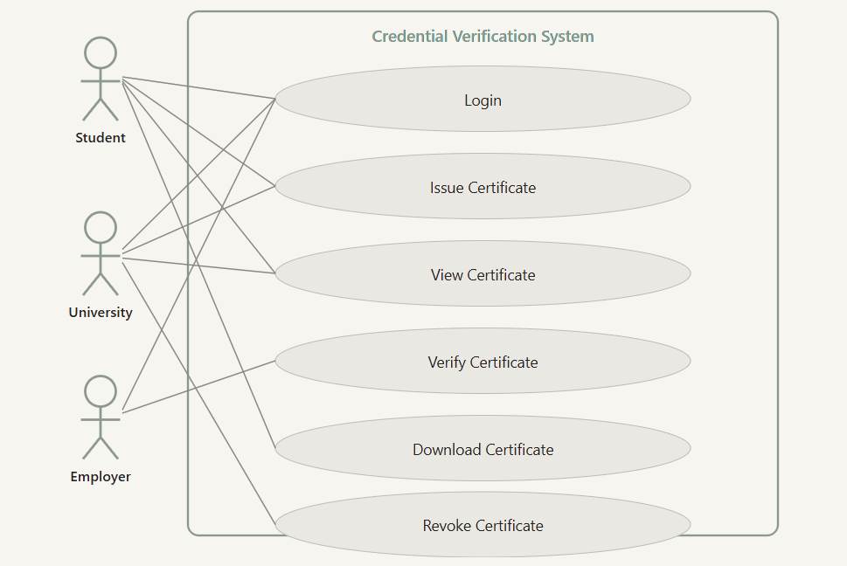
04 — UML & ER DIAGRAMS
Use Case & Entity Relationship Diagrams
Use Case Diagrams

Slide 8
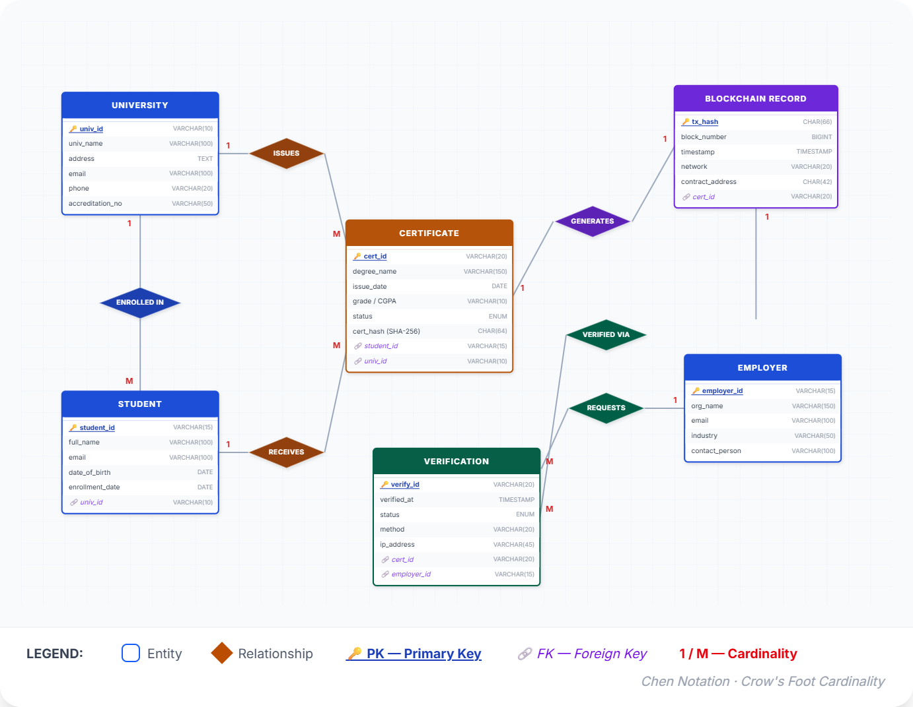
ER Diagram

Slide 9
05 — SYSTEM MODULES AND DATA FLOW
System Modules
MODULE 1
MODULE 2
MODULE 3
MODULE 4
MODULE 5
University / Admin
Student
Verification
Blockchain
Database
Issue certificates
Manage records
Revoke certificates
View certificates
Download certificates
Share QR
QR verification
Certificate ID verification
Status display
Store certificate hash
Execute smart contracts
Maintain immutable records
Store student records
Certificate metadata
Transaction references
01
02
03
04
05
SYSTEM MODULES AND DATA FLOW
7 / 10
Notes:
7

Slide 10
05 — SYSTEM MODULES AND DATA FLOW
Issuance & Verification Workflow
University Login
Issue Certificate
1
6
Enter Student Details
Student Shares QR
2
7
Generate Certificate
Employer Scans QR
3
8
Generate Certificate Hash
Blockchain Validation
4
9
Store Hash on Blockchain
Certificate Verified
5
10
SYSTEM MODULES AND DATA FLOW
8 / 10
Notes:
8

Slide 11
PROJECT SUMMARY
Achievements & Future Scope
ACHIEVEMENTS
FUTURE SCOPE
Tamper-proof verification
DigiLocker integration
1
1
Instant authentication
Government board support
2
2
Reduced fraud
International universities
3
3
QR verification
NFT credentials
4
4
Secure blockchain storage
Mobile application
5
5
PROJECT SUMMARY
9 / 10
Notes:
9

Slide 12
Thank You
Questions?
GUIDE
Ms. Chetana Bhagat
TEAM MEMBERS
Ramsha Siddiqui • Aditya Dhakarge
Tukaram Magar • Priyatam More
QR
Notes:
10

